Slide 1
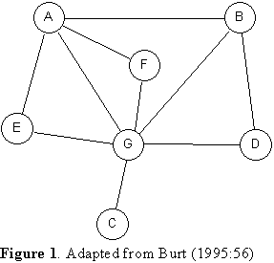
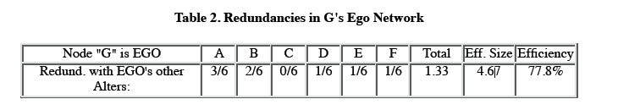
Redundancy
number of alters = n = 6
number of edges among the n alters = t = 4
redundancy = (2t)/n = (2*4)/6 = 1.33
eff. size = n - redundancy
= n - (2t)/n = 6 - 1.33 = 4.67
efficiency = eff. size/n = 4.67/6*100 = 77.8
av. degree = 2t/n
redundancy = av. degree
clustering coeff. = 2t/n(n-1) = 8/30 = .266
cc = 2t/n * 1/(n-1) = redundancy * 1/(n-1)
redundancy = cc (n-1) = .266* 5 =1.33
eff. size = n-redundancy = n - cc(n-1) = 6 - 1.33 =4.67

Slide 2
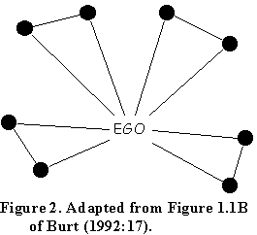
Effective Size (ES) and Clustering Coefficient (CC) - Example
n = 8, t = 4
Red. = 2t/n = (2*4)/8 = 1
eff. size = n - (2t)/n = 8 - 1 = 7
efficiency = eff. size/ n = ⅞ = .875
clustering coeff. = 2t/n(n-1)
= (2*4)/(8*7) = .143
redundancy = cc (n-1) = .143(7) = 1
eff size = n - cc(n-1) = 8 - .143(7) = 7

Slide 3

Effective Size (ES) and Clustering Coefficient (CC) - Example
N = 7
M = 6
Av D = 2*6/7 = 1.7
CC = (2*6)/(7*6) = .286
ES = 7 - (2*6)/7 = 5.285
ES = 7 -.286(6) = 5.284
ES = 7 - 1.7 = 5.3

